Slide 1
Урок английского языка в 5 классе
по теме
«Типичный английский дом» с применением технологии
«развития критического мышления»

Slide 2
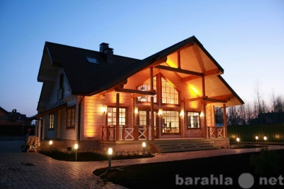

Slide 3
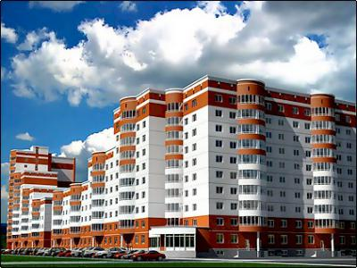

Slide 4
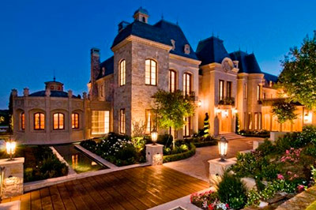

Slide 5
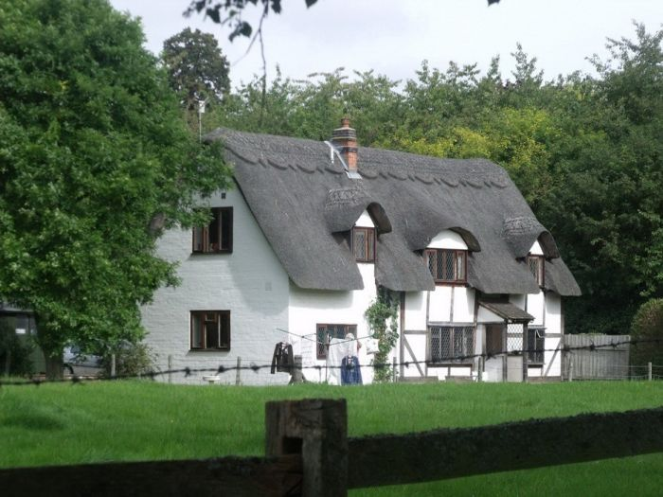
A typical English house

Slide 6
block of flats

Slide 7
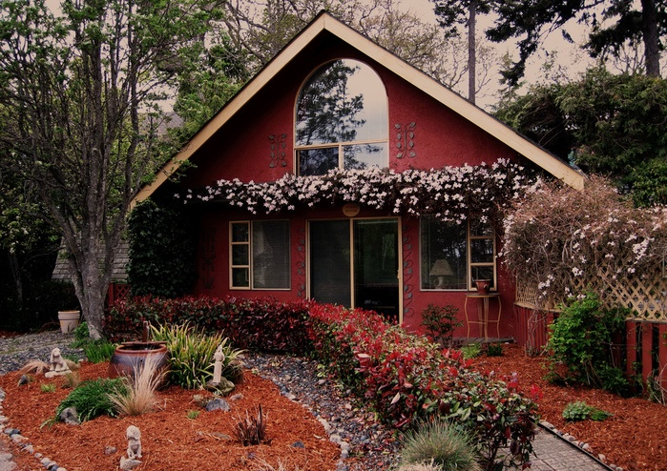
house

Slide 8
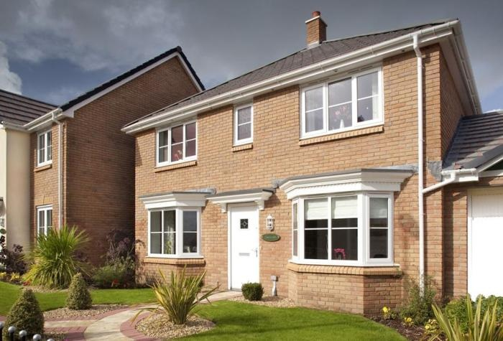
semi-detached house

Slide 9
cluster
cottage
garden
fireplace
house
block of flats
floors

Slide 10
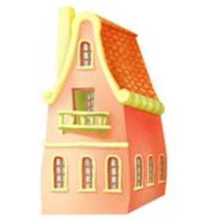
new words:
1. Type 9. Bricks
2. Central heating
3. Downstairs
4. Upstairs
5. Inside
6. Outside
7. Special features
8. fireplace

Slide 11
«Thin» and «thick» questions
«Thin» | «thick» questions
1. Is there a garden near a block of flats ? 2. Where are cottages built ? 3. Is there a central heating in a semi-detached house? etc. | 1. Are you agree that semi-detached houses more comfortable than flats ? Why … ? 2. What is the most important idea of the text? 3. What is the difference between cottages and semi-detached houses? 4. If you had a lot of money would you buy a cottage? Why … ? etc.

Slide 12
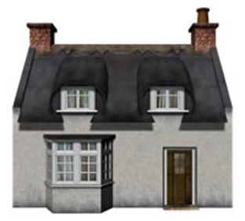
Insert
I – interactive: самоактивизирующая "V" – уже знал;
N – noting: системная разметка "+" – новое;
S – system: для эффективного "–" – думал иначе;
E – effective: чтение и размышление "?" – непонятно или же вы хотели бы получить более подробные сведения по данному вопросу.
R – reading
T – thinking

Slide 13
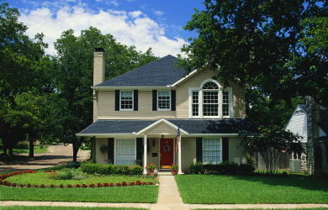
Which is their house?

Slide 14
Сinquain
1 | a noun | House
2 | two adjectives | Small, nice
3 | 3 verbs or participles | Protecting, teaching, helping
4 | an expression | It’s so warm
5 | a noun | My home

Slide 15
Thank you

