Slide 1
English Contest
«Having a good time with your family»

Slide 2
Task 1
Name members of the family

Slide 3
She is the daughter of my mother. She is my ... .
She is the sister of my mother. She is my ... .
He is the son of my mother. He is my ... .
He is the brother of my mother. He is my ... .
She is the sister of my father. She is my ... .
He is the father of my father. He is my ... .
She is the mother of my mother. She is my ... .
She is the mother of my sister. She is my ... .
He is the father of my brother. He is my ...
She is the daughter of my grandmother. She is my …

Slide 4
Task 2
Crossword

Slide 5
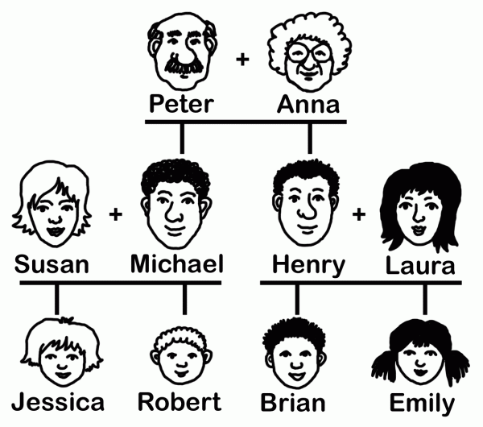

Slide 6
Task 3
Grammar task

Slide 7
Назови эти глаголы в 1 и 2 форме
Учить, узнавать
Рисовать
Пить
Ушибить
Делать
Находить
Приходить
Приносить
Давать
Встречать
Ловить
Ходить
Класть
Брать
Смотреть, видеть
Забывать
Приносить
Летать

Slide 8
Употреби was или were
Nick…… at summer camp last summer.
My mum ……. happy because I got a good mark.
My dad …… sad because he cut his finger.
Alice and Jack …… at school yesterday.
He …. busy yesterday.
The children …. in Moscow last year.
We …. In Great Britain last spring.
You …. In Africa a year ago.

Slide 9
Специальные вопросы
Bess played tennis in the park yesterday.
Where did Bess play yesterday?
When did Bess play in the park?
Why did Bess play tennis in the park yesterday?
With whom did Bess play tennis in the park yesterday?
Who played tennis in the park yesterday?

Slide 10
Составьте как можно больше вопросительных предложений
My sister watered the flowers last Tuesday.
Bill and Pam went to the Green School a year ago.
I played football in the yard last summer.
Alex repaid the bike last Monday.

Slide 11
So, let’s decide who is the winner.

Slide 12
Thank you for attention
Презентацию подготовила
Мелешко Олеся Геннадьевна МБОУ «Лицей Сигма» г. Барнаул учитель английского языка

Slide 13
Используемая литература
Кросворд по теме «Моя семья» был взят с сайта Петровой Натальи Николаевны
http://like2teach.tmweb.ru/fun/crosswords_024.html

